Slide 1
Preparing Graduate Students for
Non-Academic Careers
American Association of Physics Teachers Meeting
Orlando, FL
January 6, 2014
Panel DC02
Dr. Lawrence Woolf
General Atomics Sciences Education Foundation
General Atomics Aeronautical Systems, Inc.
San Diego, CA 92121

Slide 2
Goals for this talk
Describe key findings of the Second Graduate Education in Physics Conference relevant to preparing students for non-academic careers
  Participant stories/comments
  Conference findings

Slide 3
Conference program for Preparation for Non-Academic Careers
Panel session 1 with 3 panel members (75min)
Breakout session 1 (75min)
  Non-academic careers
  Improving the graduate curriculum: multi/inter disciplinary courses
  General professional skills: leadership/team building/communication
Breakout session 3 (75 min)
  University, industry and national lab partnership for graduate education

Slide 4
Panel Session 1: Preparation for Non-Academic Careers
Zelda Gills (Lockheed Martin Corp.)
Alex Panchula (First Solar, Inc.)
Kathy Prestridge (Los Alamos National Lab)
Moderator: Larry Woolf (General Atomics Aeronautical Systems, Inc.)

Slide 5
Prestridge (LANL) take-aways
Technical research skills
  Collaborations across experiment, theory, modeling, simulation
  Intellectual agility: applying existing knowledge to new situations
Communication skills
  Technical results to other technical experts and program managers
People skills
  Listen to/respect/value: technicians to senior management

Slide 6
Prestridge summary
Project management skills
  Define project scope, set schedules and budgets
  Report incremental/monthly progress to management
Evolution of skills
  Should begin in graduate school and not be a step function
“Agile, out-of the box thinking, communication, management, and people skills are hard requirements for future researchers”

Slide 7
Panchula (First Solar) Take-Aways
Gaps in physics education
  Exposure to toolsets used in industry: software, programming, statistics
  Business methods
Need to train physicists to write “the how” not “the what” in resumes
  Instead of “Magnetotransport in Magnetic Nanostructures”
  Use: “Experimental design, execution, data analysis and mathematical models of complex systems”
Invite alumni in industry to speak to students

Slide 8
Interesting Comments – Panel Session 1
Nobody makes an effort to teach stat mech for physicists and chemists and engineers
Courses should provide connections to multiple scientific and applied topics – interdisciplinary
Need to change culture that students who go into industry are failures

Slide 9
Breakout Session 1: Non-academic careers Take-Aways (Zollner)
Most graduate students will not have academic careers – students should be informed about employment statistics
Lack of tracking of career paths of PhDs
Lack of knowledge of skills that PhDs find valuable in their jobs
Need to set realistic educational objectives and then survey alumni to demonstrate they have been met

Slide 10
Interesting Comments – Improving the Graduate Curriculum: Multi/Inter Disciplinary Courses
Need to show students connections to modern applications
  Too many theorists teach graduate courses
  Experimentalists more likely to make connections
Make students active participants in learning
Core curriculum should be updated to be relevant but each department should decide how to do that

Slide 11
Interesting Comments – Professional Skills
Does use of term soft skills imply low priority?
  Better to use critical or professional skills
  Need APS statement on professional skills
  Skills training should be intentional, not accidental

Slide 12
Conference Findings
Most physics PhDs will have non-academic careers

Slide 13
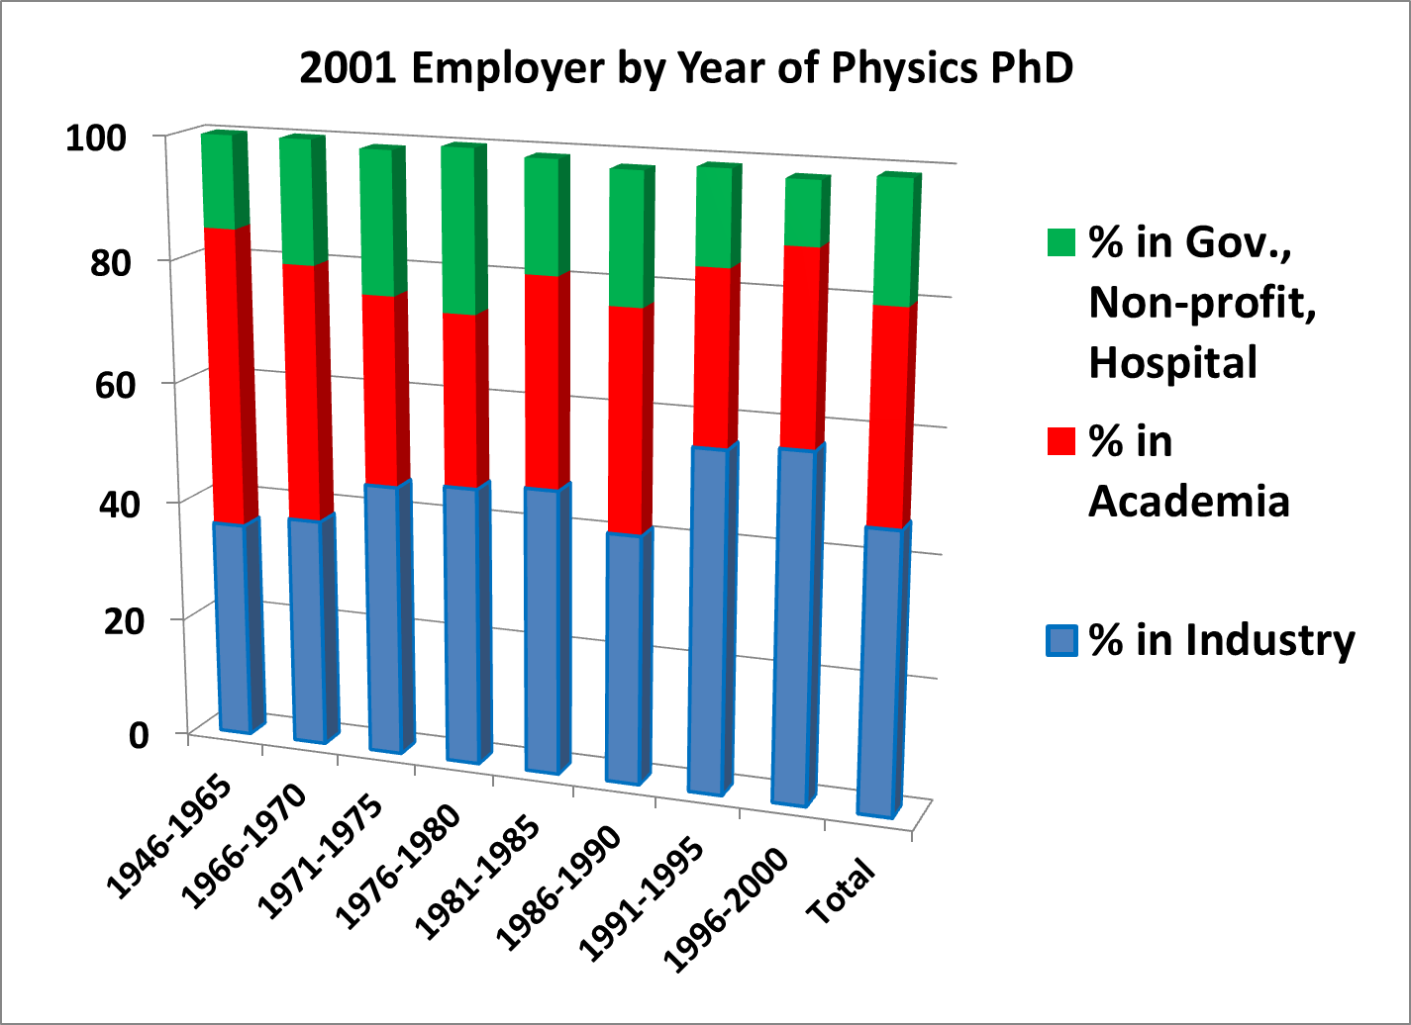
Majority of Physics PhDs are in Industry
Career Outcomes for PhD Physicists – Information from the NSF’s Survey of Doctoral Recipients, by Michael Neuschatz and Mark McFarling (AIP Statistical Research Center report)

Slide 14
2006 NSF Survey of Employed Doctoral Scientists and Engineers
Physics:
  Total employed: 34,310
  Teaching as primary or secondary work activity: 8,270 (24%)
Table 15 of the 2006 NSF survey: Characteristics of Doctoral Scientists and Engineers in the United States: 2006
http://www.nsf.gov/statistics/nsf09317/content.cfm?pub_id=3920 id=2

Slide 15
2008 NSF Survey of Doctorate Recipients (SDR)
34,900 employed physicists
13,000 at educational institutions (37%)
  9,700 are post-secondary physics teachers (28%)
21,900 at non-academic institutions (63%)
  17,200 at private (49%)
  3,500 at government (10%)
  1,200 self-employed (3%)
Characteristics of Doctoral Scientists and Engineers in the United States: 2008; Tables 2, 8
http://www.nsf.gov/statistics/nsf13302/pdf/nsf13302.pdf

Slide 16
Physics Doctorates Initial Employment
Potentially permanent positions accepted by PhD classes of 2009 & 2010
  Academic: 23%
  Private sector: 57%
  Government: 16%
  Other: 4%
  N=365
  Table 1 at: http://www.aip.org/sites/default/files/statistics/employment/phdinitemp-p-10.pdf

Slide 17
Conference Findings
Expert learning and innovation skills
  Apply existing knowledge to new situations – engineering/applied focus
  Solve well defined and ill-defined problems
  Use software, toolsets common in industry, statistics
  Graduate classes can include more modern applications and connections

Slide 18
Conference Findings
Leadership
  Conceptualizing and planning projects
  Focus team on attaining goals
  Keep team and stakeholders informed
  Graduate students can develop leadership
    Mid to late in graduate career in their research
    Mentor junior graduate students and undergraduates

Slide 19
Conference Findings
Project Management
  Define project scope
  Develop and follow schedule
  Develop and follow budget
  Graduate students can begin using their thesis research as the project

Slide 20
Conference Findings
Communication Skills
  Verbal
    Co-workers, technicians, program managers, upper management, funding sources
  Written
    Monthly reports, proposals, white papers, test plans, test results, final reports
    Graphs and tables for technical and non-technical audiences
  Graduate students can hone these skills via thesis updates to advisors and graduate students

Slide 21
Conference Findings
Interpersonal skills
  Work productively with a team as leader or member
  Listening skills
  Interact with customers
Later stage graduate students can lead early stage graduate students and interact with funding sources

Slide 22
Conference Findings
Proposal Writing
  Proposals to internal customers
  Proposals to external customers
  Develop planning, research, and writing skills
Graduate students can:
  Assist their professors in proposal writing early in their research
  Take leadership role in proposal writing later in their research

Slide 23
Conference Findings
Connections with industry: research collaborations/internships provide students with better understanding of non-academic careers
Need to value a broad range of career paths
Include modern applications/engineering aspects/connections to other areas in graduate classes
Connect with engineering or business schools for professional skills training

Slide 24
Conference Findings
Professional masters programs include many business/soft skills
PhD programs could use professional masters programs as template

Slide 25
Primary Resources
Conference Resources (background readings)
  http://www.aps.org/programs/education/graduate/conf2013/resources.cfm
Conference Program (session goals, questions to be considered)
  http://www.aps.org/programs/education/graduate/conf2013/program.cfm
Presentations and Notes (scribe notes for each session, presenters opening remarks, presentations)
  http://www.aps.org/programs/education/graduate/conf2013/presentations.cfm
Conference web site
  http://www.aps.org/programs/education/graduate/conf2013/index.cfm

Slide 26

Other resources
“Things your adviser never told you: Entrepreneurship’s role in physics education” by Douglas Aron
  Physics Today, August 13, 2013, p. 42-47
“The Art of Being a Scientist: A Guide for Graduate Students and their mentors” by Roel Snider and Ken Larner
“Preparing Graduate Students for Careers in Industry” by Larry Woolf
  http://www.aps.org/units/fed/newsletters/spring2013/industry.cfm
Is Industry Really a "Nontraditional" Career? by Jeffrey Hunt, Boeing Corporation
  http://www.aps.org/units/fiap/newsletters/201311/
Best practices for Educating Students about Non-Academic Jobs
  http://www.aps.org/careers/guidance/advisors/bestpractices/

Slide 27
PhD Physicist: View from Graduate School
Thesis
Field
Physics

Slide 28
PhD Physicist: View from Industry
Proposal writing
Plans/ Reports
Engineering
Modeling
Manufacturing
Field
Documentation
Physics
Program Mgmt
Technology Assessment/ IP
Presentations
Product development

Slide 29
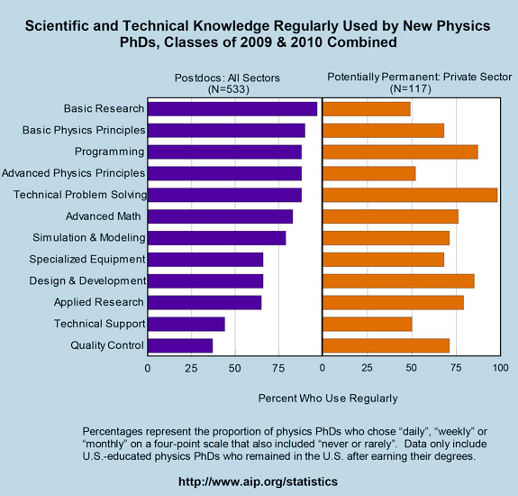
Scientific and Technical Knowledge Used
Recent Physics Doctorates: Skills Used Satisfaction with Employment
Data from the degree recipient follow-up survey for the classes of 2009 and 2010
Garrett Anderson and Patrick Mulvey
http://www.aip.org/statistics/trends/reports/physdoctorates0910.pdf

Slide 30
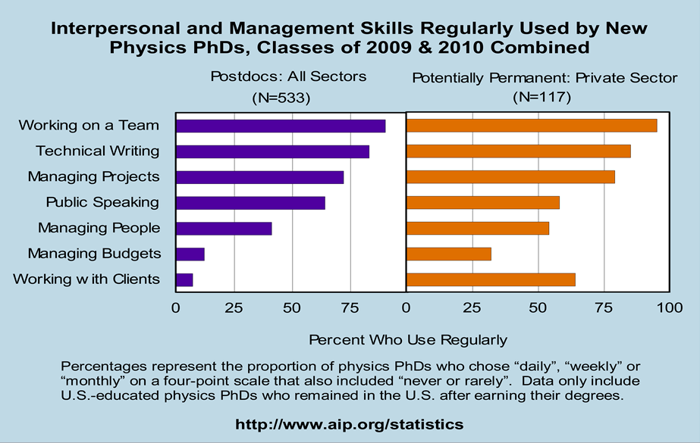
Interpersonal and Management Skills
Recent Physics Doctorates: Skills Used Satisfaction with Employment
Data from the degree recipient follow-up survey for the classes of 2009 and 2010
Garrett Anderson and Patrick Mulvey
http://www.aip.org/statistics/trends/reports/physdoctorates0910.pdf

Slide 31
Conclusions
Majority of physics PhDs will have non-academic careers
Students need professional skills
Courses should include connections and modern applications
Need to engage non-academic physicists

Slide 32
Back-up slides

Slide 33
Topics covered in ScienceWorks at Carthage College
D. N. Arion, “Things your adviser never told you: Entrepreneurship’s role in physics education,” Physics Today, August 13, 2013, p. 42-47

Slide 34
Intelligence
Actionable: can be used and applied to novel situations
Connective: connects to other areas
Robust: widely applicable in most situations

Slide 35
Largest employers as of 1998 – most recent AIP survey
Largest 19 Employers*
Raytheon Corporation IBM Lockheed Martin Corporation Lucent Technologies Boeing Company Eastman Kodak Company Science Applications International Corporation General Atomics Hewlett-Packard Company | Northrop Grumman Corporation AT T Schlumberger Limited Motorola Incorporated Rockwell International Corporation Seagate Technologies Osram Sylvania Maxwell Optical Industries Varian Associates 3M Company
* The above companies employ 30% of industrially-employed PhD physicist members.
SOURCE: AIP Membership Sample Survey, 1998

