Slide 1
Physics in Industry: From Personal Story to National Perspective UCSD Physics Colloquium
Dr. Larry Woolf
General Atomics Aeronautical Systems, Inc.
General Atomics Sciences Education Foundation
April 10, 2014
www.ga-asi.com
www.sci-ed-ga.org

Slide 2
Outline
Part 1: personal perspective (n=1)
An example of an industrial physics career
An example of education possibilities in industry
Part 2: national perspective (n>1)
Second graduate education in physics conference
Perspective of others and model systems
Concluding remarks

Slide 3
Part1 : Personal perspective

Slide 4
My Brief History
PhD UCSD, Low temperature heat capacity of magnetic superconductors, Prof. Brian Maple 1980
Post-doc at Exxon Research, 1980-1982
Hired as solid state physicist at General Atomics (GA) in 1982 to help develop non-nuclear programs. At GA for 31 years – mostly materials R&D
Every story and perspective of life in industry is unique and changes depending on the stage of one’s career

Slide 5
Graphite and intercalated graphite fibers- potential lightweight electrical conductors
Graduate school →
Set up low temperature high H lab to measure magnetoresistance

Slide 6
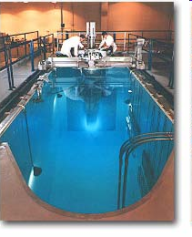
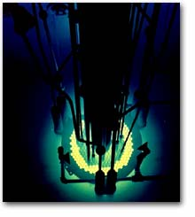
Neutron transmutation doping of silicon in TRIGA reactor – determining doping/fluence, measure properties
→ Radiation damage

Slide 7
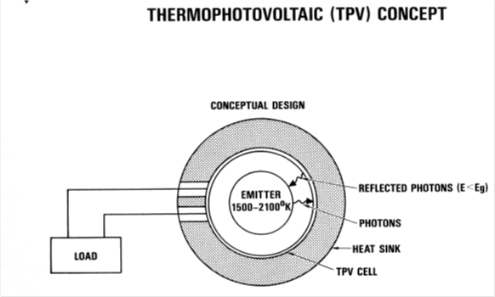
Model thermophotovoltaic energy conversion systems and test cells – space nuclear power
→ High temperature materials + optical properties

Slide 8
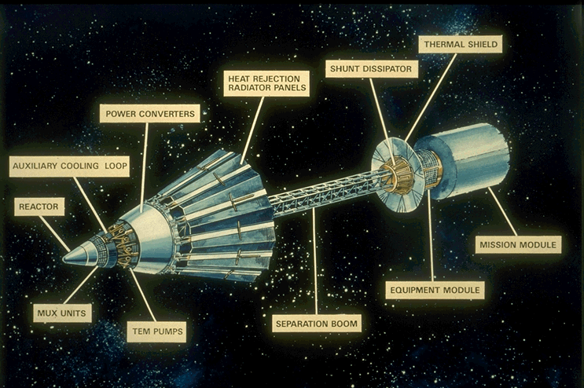
Develop/test high temperature electrical insulators for potential space nuclear power systems
High temperature materials + radiation damage →
Direct heat to electricity
Thermoelectric
Thermionic
100V, 1300K, high neutron fluence
→ Ceramic materials

Slide 9
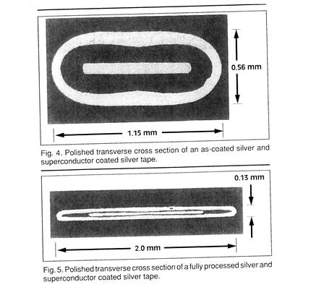
HTS discovered: Led high temperature superconducting (HTS) wire development project
Graduate school + ceramic materials →
7 years, papers, patents, presentations
Effort was commercially unsuccessful
→ Thin film coatings

Slide 10
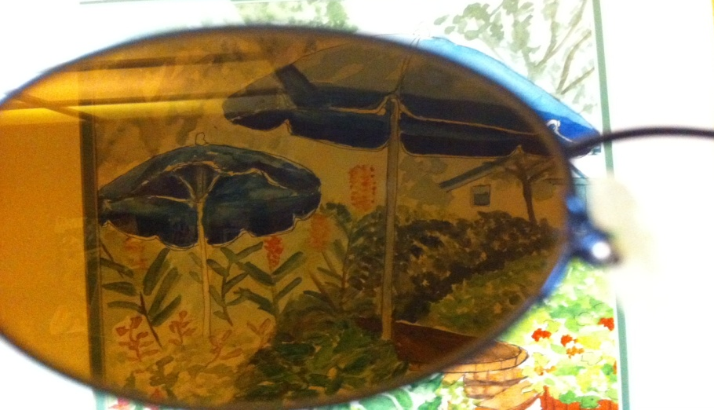
Design and fabricate one-way imaging materials for windows
Thin film coatings + optical properties →

Slide 11
One-way imaging film – multilayer coatings
T1
R1
T2
R2
Transmittance 1 =
Transmittance 2
Reflectance 1≠ Reflectance 2
400-700nm

Slide 12
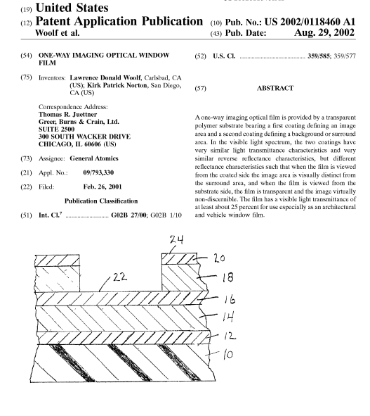
One-way imaging window film at Rome Airport
http://www.usglassmag.com/Window_Film/BackIssues/2003/March-April03/X-TEX.GIF

Slide 13
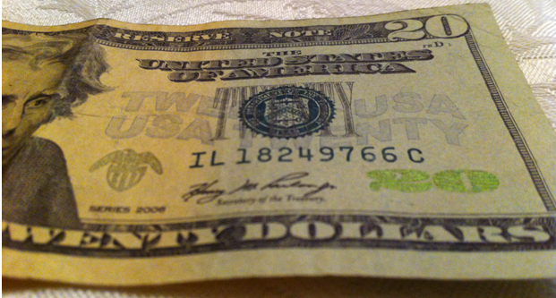
What’s in your wallet?
Multilayer coatings –
color changing pigment

Slide 14
Evolution of job responsibilities over time

Slide 15
Levels of employment in industry: Level ~$ (physics) (Aviation Week and Space Technology 2009 Workforce Study)
Level 1. Individual contributor working under direction of technical leadership ($66K)
Level 2. Improved knowledge of product, some self-direction, contributes to engineering estimates ($80K)
Level 3. Significant knowledge of products, decisions may have significant impact on costs, schedule, and performance. ($99K)
Level 4. Serves as system architect, recommend tools and techniques for continuous improvement, lead preparation of proposals ($120K)
Level 5. Develops product and technical roadmaps and competitive assessments, leads or reviews proposals ($138K)
Level 6. Industry expert in knowledge of products and systems, directs sophisticated design, analysis and testing of complex systems, provides direction on strategic technology plans for company ($177K)

Slide 16
What do I do all day?
Physics
Generate ideas, develop/design solution to problems
Development
Develop overall plan (product must be manufacturable)
Initial development to pilot scale production
Communication
Write/review reports/programs/proposals: technical, cost, contractual
Prepare/give presentations
Discuss plans/issues with technicians, engineers, scientists, managers
Management
Manage and schedule both people and equipment
Safety, quality, intellectual property, strategic planning

Slide 17
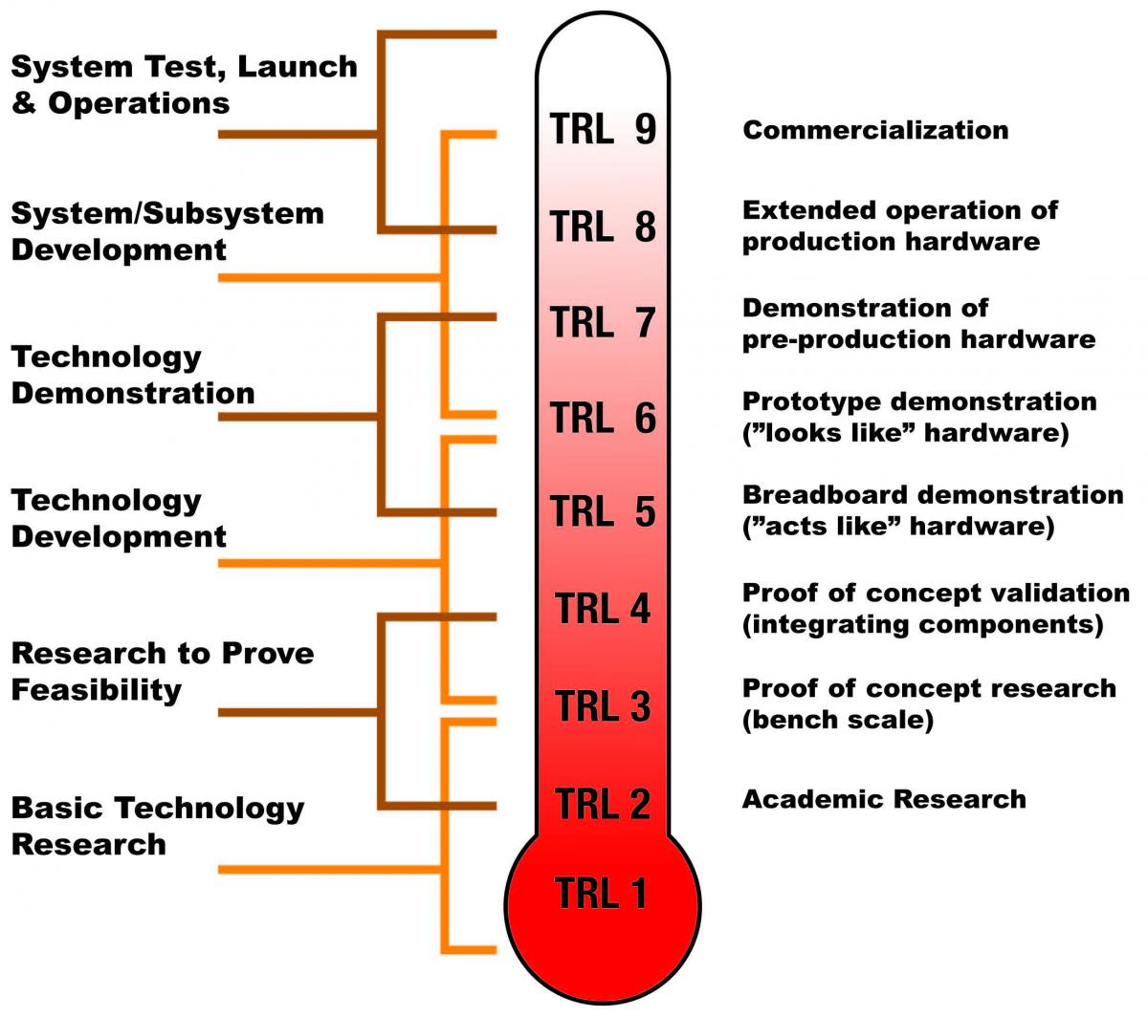
Major differences between industry and university
Technology Readiness Levels (TRL)
Industry: TRL 2-9
University: TRL 1

Slide 18
Advantages of Careers in Industry
Goal is development of a product
Satisfaction of seeing your efforts make a difference to people
Opportunities for patents, business development
Challenge of not just doing science, but applying science to technology, then figuring out how to commercialize it in dynamic marketplace
Challenge of learning how to perform R&D and scale-up under schedule, cost, equipment, quality, personnel, facilities constraints
Varied career opportunities: science, technology, manufacturing, program management, group management, quality
Many different projects; constant learning needed
Pay, bonus pool, stock options

Slide 19
Disadvantages of Careers in Industry
Often minimal publications/presentations and interactions with peers due to proprietary, export controls, security issues
Reduced likelihood of being recognized for your achievements from an academic perspective, e.g. awards, fellowships
Focus on a defined goal (NOT curiosity driven)
Limited freedom to pursue your personal interests
No sabbaticals, no tenure
Need to rapidly reinvent yourself as technologies and business areas change

Slide 20
My15 Point Guide to Success
1. Be responsive – return phone calls and emails promptly. When asked to do something, do it on time – be sure to ask when it should be done. Document requests and responses in writing.
2. Become the world expert in your particular area.
3. Continually expand the depth and breadth of your knowledge and skills.
4. Utilize all information resources available - books, science magazines, web sites, search engines, search services, colleagues, patents, trade magazines, catalogs, sales reps, conferences.
5. Get involved with or develop projects that have a high probability of contributing to the company’s success.

Slide 21
My 15 Point Guide to Success
6. Understand and be aware of project constraints such as your personnel and company capabilities, competitor’s strengths, and customer needs.
7. Innovate continuously. Always push your envelope as well as the science and technology envelope. Stay uncomfortable with what your skills and knowledge are.
8. Document your work in manner that can be easily understood by a co-worker a year from now. Use spreadsheets, tables and charts to convey your results in a concise, visual, and easy-to-understand manner.
9. Make sure that you learn something useful from any tests or experiments that you perform. These results should form the basis for future tests.
10. Learn from your mistakes. Don’t repeat them.

Slide 22
My 15 Point Guide to Success
11. Don’t believe everything you are told, even if it is company lore or told to you by an expert. Be skeptical.
12. Enjoy your work.
13. Treat everyone you work with (above and below you) with respect. Thank them for their work. Acknowledge their contributions whenever possible. Keep them informed as to what you are doing and why you are doing it.
14. Have a sense of humor.
Develop a unique and necessary skill and knowledge set that complements those of your co-workers and greatly increases the value of your project/team. Be indispensible.

Slide 23
Education activities are possible in industry
Outreach program started at GA in 1992
Many companies have education outreach programs
Details and funding are highly dependent on the company, management support, and the initiative and desire of the individual scientist
Co-developed materials science module, then graphite pencil module
Led to work with APS, NSF, Lawrence Hall of Science, BSCS, CA science standards

Slide 24
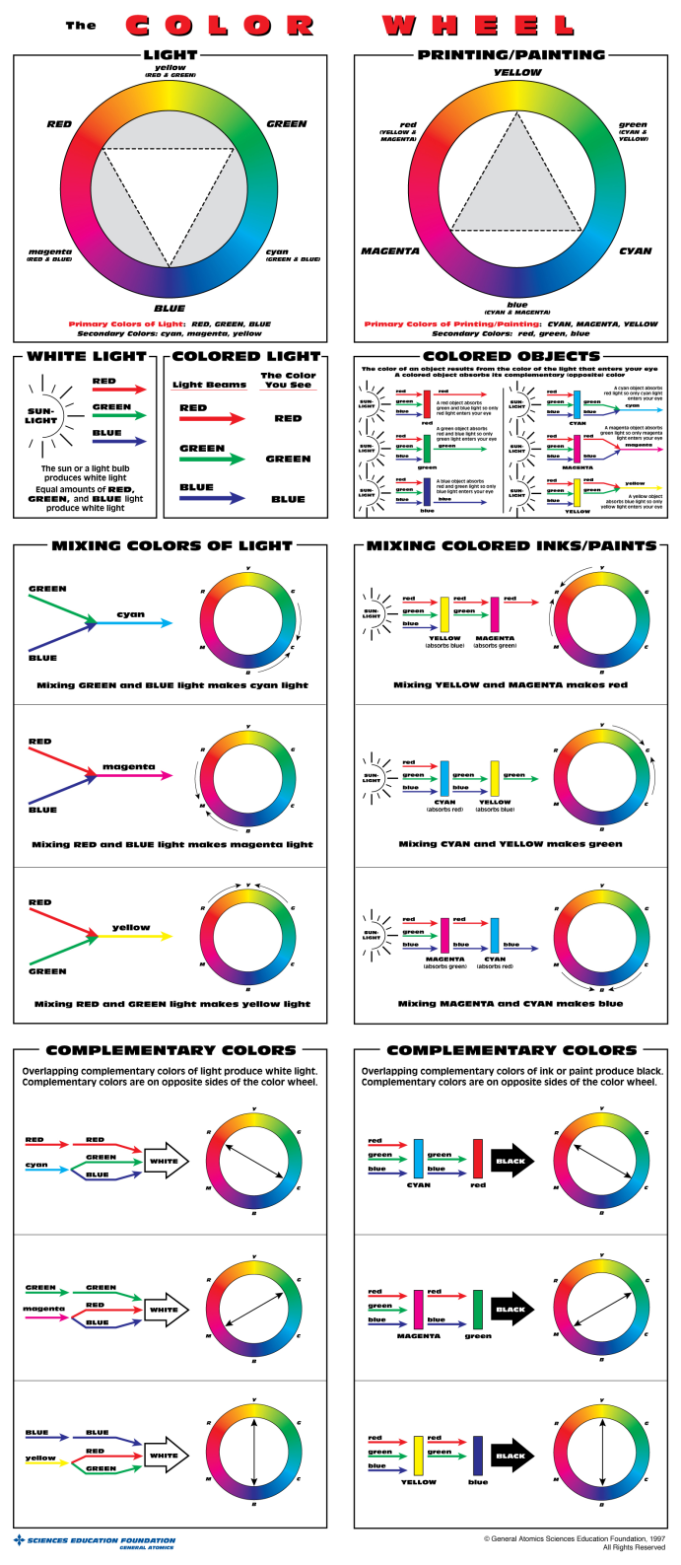
The color wheel
Confusion about primary colors and correct color wheel

Slide 25
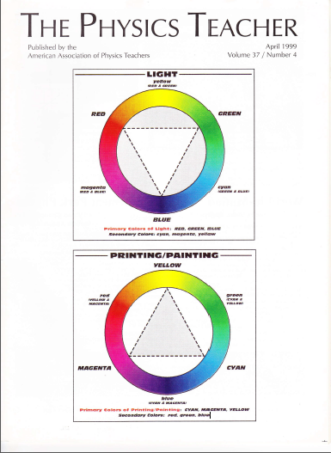
Publicity for the correct color wheels …

Slide 26
Blue water confusion: Light Matters Poster

Slide 27
Misconceptions about seasons
Including Private Universe Project

Slide 28
A guest appearance on The Big Bang Theory …

Slide 29
And another

Slide 30
…and another

Slide 31
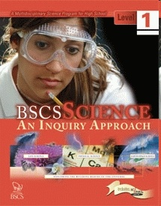
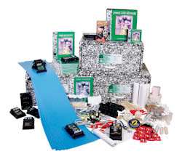
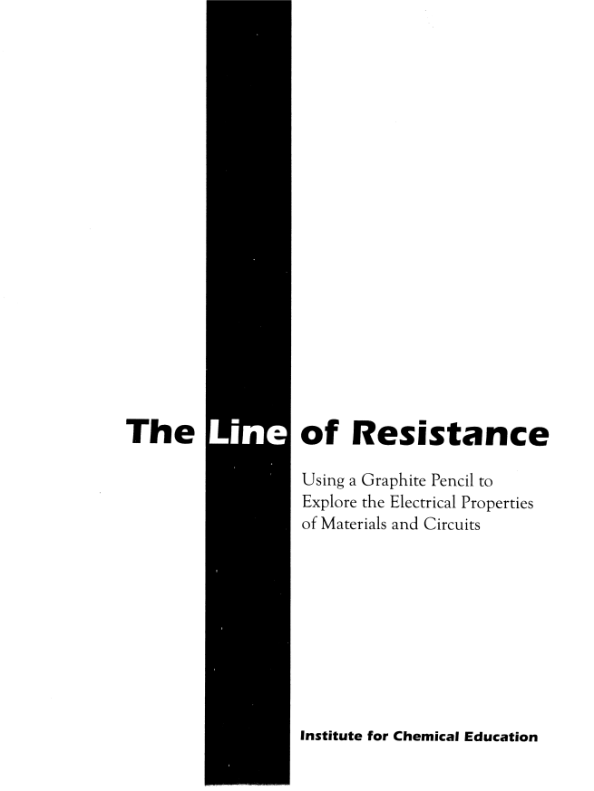
Curriculum designer, writer, and content reviewer for middle and high school science program

Slide 32
Conclusion of Part 1
Physics careers in industry
Varied
Rewarding
Dynamic
Challenging
Many aspects not included in standard graduate curriculum (see Part 2)
Education opportunities in industry
Depends on personal motivation and corporate culture

Slide 33
Part 2: National Perspective
Increase the sample size
Second Graduate Education in Physics Conference
Perspective of others

Slide 34
2nd Graduate Education in Physics Conference Preparation for Non-Academic Careers
Panel session 1 with 3 panel members
Breakout session 1
Non-academic careers
Improving the graduate curriculum: multi/inter disciplinary courses
General professional skills: leadership/team building/communication
Breakout session 3
University, industry and national lab partnership for graduate education

Slide 35
Panel Session 1: Preparation for Non-Academic Careers
Zelda Gills (Lockheed Martin Corp.)
Alex Panchula (First Solar, Inc.)
Kathy Prestridge (Los Alamos National Lab)
Moderator: Larry Woolf (General Atomics Aeronautical Systems, Inc.)

Slide 36
Prestridge (LANL) take-aways
Technical research skills
Collaborations across experiment, theory, modeling, simulation
Intellectual agility: applying existing knowledge to new situations
Communication skills
Technical results to other technical experts and program managers
People skills
Listen to/respect/value: technicians to senior management

Slide 37
Prestridge summary
Project management skills
Define project scope, set schedules and budgets
Report incremental/monthly progress to management
Evolution of professional skills
Should begin in graduate school and not be a step function
“Agile, out-of the box thinking, communication, management, and people skills are hard requirements for future researchers”

Slide 38
Panchula (First Solar) Take-Aways
Gaps in physics education
Exposure to toolsets used in industry: software, programming, statistics
Business methods
Need to train physicists to write “the how” not “the what” in resumes
Instead of “Magnetotransport in Magnetic Nanostructures”
Use: “Experimental design, execution, data analysis and mathematical models of complex systems”
Invite alumni in industry to speak to students

Slide 39
Interesting Comments – Panel Session 1
Nobody makes an effort to teach stat mech for physicists and chemists and engineers
Courses should provide connections to multiple scientific and applied topics – interdisciplinary
Need to change culture that students who go into industry are failures

Slide 40
Breakout Session 1: Non-academic careers Take-Aways (Zollner)
Most graduate students will not have academic careers – students should be informed about employment statistics
Lack of tracking of career paths of PhDs
Lack of knowledge of skills that PhDs find valuable in their jobs
Need to set realistic educational objectives and then survey alumni to demonstrate they have been met

Slide 41
Interesting Comments – Improving the Graduate Curriculum: Multi/Inter Disciplinary Courses
Need to show students connections to modern applications
Too many theorists teach graduate courses
Experimentalists more likely to make connections
Make students active participants in learning
Core curriculum should be updated to be relevant but each department should decide implementation

Slide 42
Conference Findings
Most physics PhDs will have non-academic careers

Slide 43
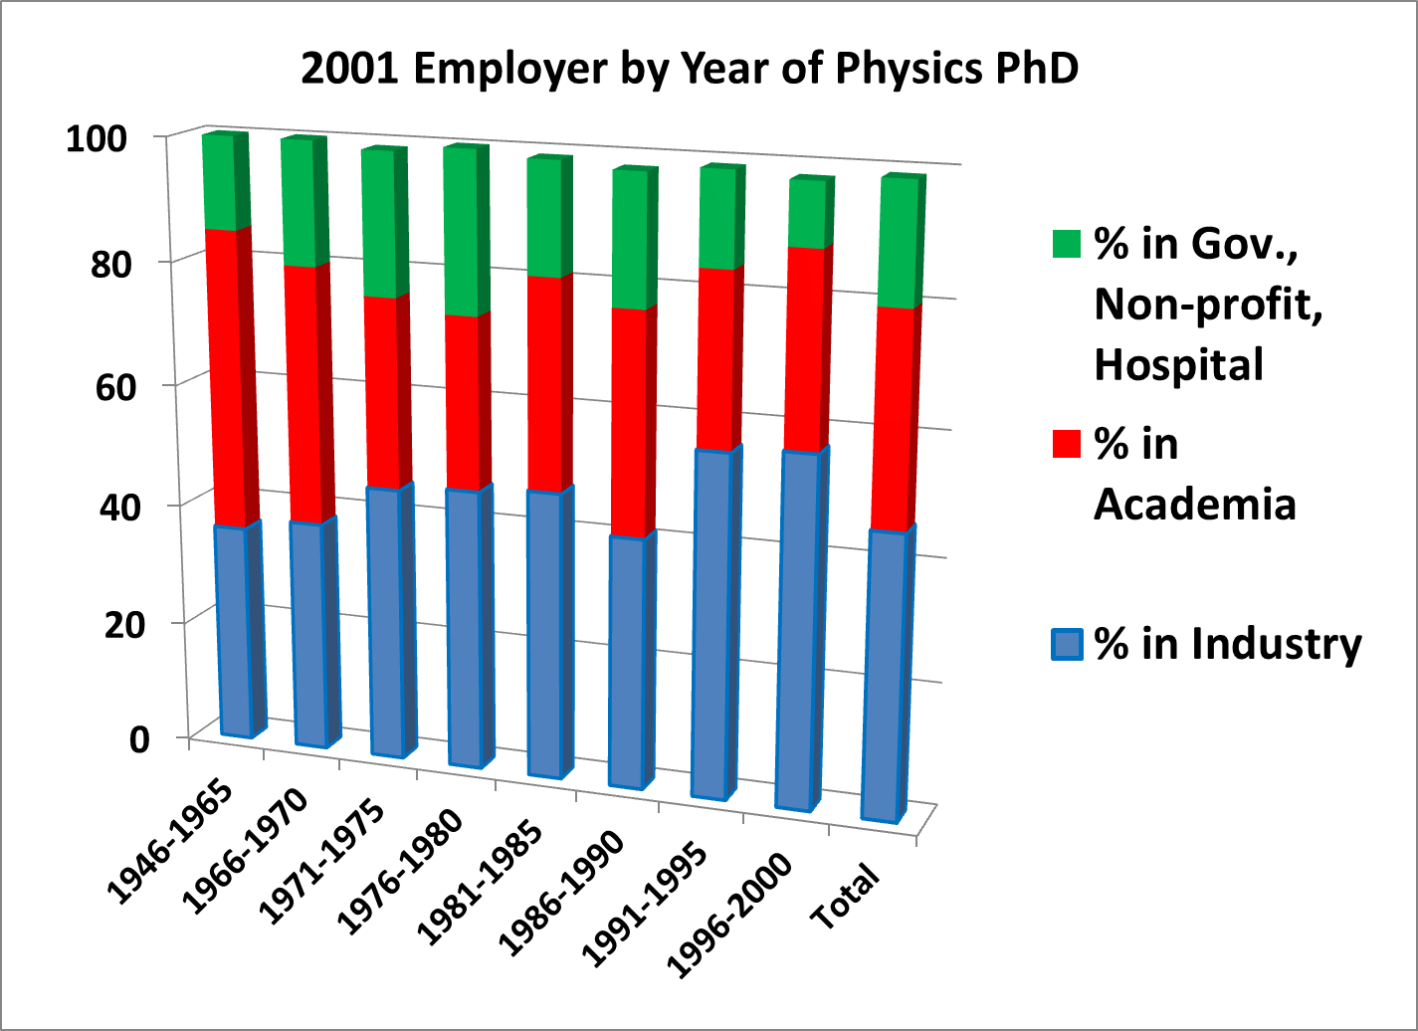
Majority of Physics PhDs are in Industry (NSF, AIP)
Career Outcomes for PhD Physicists – Information from the NSF’s Survey of Doctoral Recipients, by Michael Neuschatz and Mark McFarling (AIP Statistical Research Center report)

Slide 44
2008 NSF Survey of Doctorate Recipients (SDR)
34,900 employed physicists
13,000 at educational institutions (37%)
9,700 are post-secondary physics teachers (28%)
21,900 at non-academic institutions (63%)
17,200 at private (49%)
3,500 at government (10%)
1,200 self-employed (3%)
Characteristics of Doctoral Scientists and Engineers in the United States: 2008; Tables 2, 8
http://www.nsf.gov/statistics/nsf13302/pdf/nsf13302.pdf

Slide 45
Physics Doctorates Initial Employment (AIP)
Potentially permanent positions accepted by PhD classes of 2009 & 2010
Academic: 23%
Private sector: 57%
Government: 16%
Other: 4%
N=365
Table 1 at: http://www.aip.org/sites/default/files/statistics/employment/phdinitemp-p-10.pdf

Slide 46
Largest employers as of 1998 – most recent AIP survey!
Largest 19 Employers*
Raytheon Corporation IBM Lockheed Martin Corporation Lucent Technologies Boeing Company Eastman Kodak Company Science Applications International Corporation General Atomics Hewlett-Packard Company | Northrop Grumman Corporation AT T Schlumberger Limited Motorola Incorporated Rockwell International Corporation Seagate Technologies Osram Sylvania Maxwell Optical Industries Varian Associates 3M Company
* The above companies employ 30% of industrially-employed PhD physicist members.
SOURCE: AIP Membership Sample Survey, 1998

Slide 47
Conference Findings
Provide career information and guidance
Faculty should educate both themselves and students about non-academic career paths and employment statistics
Invite speakers/alumni from local industries (Thank you!)
Resumes and letters of recommendation should reflect broadly on what students can do
Provide skills that are broadly valued in industry
Departments should intentionally provide preparation for non-academic careers

Slide 48
Conference Findings
Expert learning and innovation skills
Apply existing knowledge to new situations – engineering/applied focus
Solve well defined and ill-defined problems
Use software, toolsets common in industry, statistics
Exposure to intellectual property
Graduate classes can include more modern applications and connections

Slide 49
Conference Findings
Leadership
Conceptualizing and planning projects
Focus team on attaining goals
Keep team and stakeholders informed
Graduate students can develop leadership
Leading their thesis research
Mentor junior graduate students and undergraduates assisting with their PhD

Slide 50
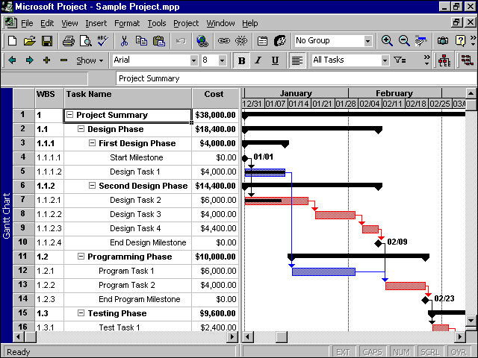
Conference Findings
Project Management
Define project scope
Develop and follow schedule
Develop and follow budget
Graduate students can use their thesis research as their project (track progress to PhD)

Slide 51
Conference Findings
Communication Skills
Verbal
Co-workers, technicians, program managers, upper management, funding sources
Written
Monthly reports, proposals, white papers, test plans, test results, final reports
Graphs and tables for technical and non-technical audiences
Graduate students can hone these skills via thesis updates to advisors and fellow graduate students

Slide 52
Conference Findings
Interpersonal skills
Work productively with a team as leader or member
Listening skills
Interact with customers
Later stage graduate students can lead early stage graduate students and interact with funding sources

Slide 53
Conference Findings
Proposal Writing
Proposals to internal customers
Proposals to external customers
Develop planning, research, and writing skills
Graduate students can:
Assist their professors in proposal writing early in their research
Take leadership role in proposal writing later in their research

Slide 54
Conference Findings
Industrial Research Experiences and Connections
Connections with industry: research collaborations/internships provide students with better understanding of non-academic careers
Need to value a broad range of career paths
Possibly connect with engineering or business schools for professional skills training

Slide 55
Conference Findings
Professional masters programs include many business/professional skills
PhD programs could use professional masters programs as template

Slide 56
Topics covered in ScienceWorks at Carthage College
Douglas N. Arion, “Things your adviser never told you: Entrepreneurship’s role in physics education,” Physics Today, August 13, 2013, p. 42-47

Slide 57
Conference Conclusions
Majority of physics PhDs will have non-academic careers:
Graduate programs should consider this fact
Students need professional skills
Courses should include connections and modern applications
Need to engage non-academic physicists

Slide 58
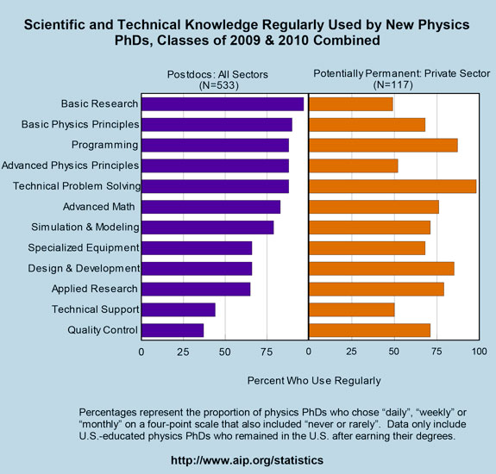
Recent Physics Doctorates: Skills Used Satisfaction with Employment
Data from the degree recipient follow-up survey for the classes of 2009 and 2010
Garrett Anderson and Patrick Mulvey
http://www.aip.org/statistics/trends/reports/physdoctorates0910.pdf

Slide 59
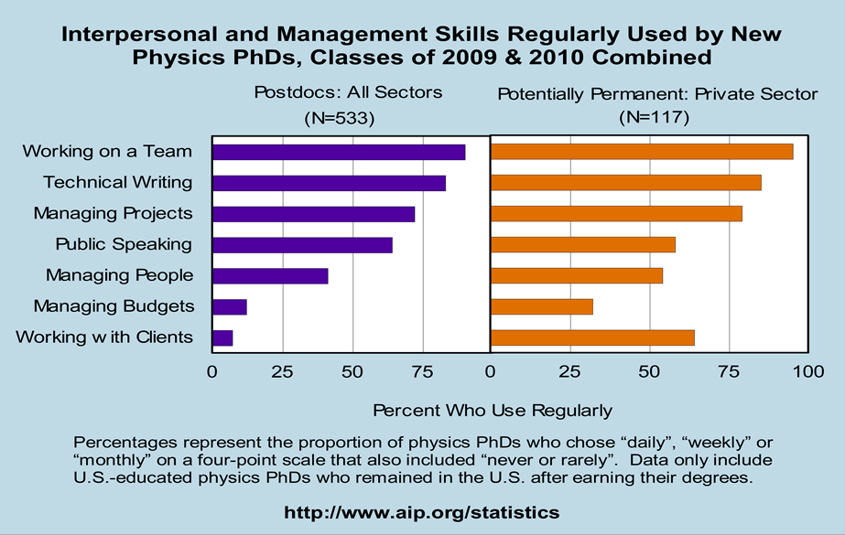
Recent Physics Doctorates: Skills Used Satisfaction with Employment
Data from the degree recipient follow-up survey for the classes of 2009 and 2010
Garrett Anderson and Patrick Mulvey
http://www.aip.org/statistics/trends/reports/physdoctorates0910.pdf

Slide 60
Survey of MIT ME Grads ‘92-’96
Source of Learning
did not
100%
else-
where
80%
job
60%
grad
school
How & Why
40%
ME Core
Professional skills
MIT
ungd
20%
0%
DYNAMICS
TESTING
HEAT TRANSFER
TEAMWORK
DESIGNING
FLUID MECHANICS
MANUFACTURNIG
SYSTEM THINKING
COMUNICATIONS
MARKET CONTEXT
UNDERLYING SCIENCES
THERMODYNAMICS
DEVELOPING AN IDEA
MECHANICS OF SOLIDS
INDEPENDENT THINKING
UNDERLYING MATHEMATICS
ENGINEERNIG DESIGN PROCESS
SYSTEMS DYNAMICS AND CONTROL
PERSONAL SKILLS AND ATTRIBUTES
EXTERNAL AND SOCIETAL CONTEXT
MECHANICAL BEHAVIOR OF MATERIALS
PROFESSIONAL SKILLS AND ATTITUDES
ENTERPRISE AND BUSINESS CONTEXT
EXPERIMENTATION AND KNOWLEDGE DISCOVERY
ENGINEERING REASONING AND PROBLEM SOLVING
From MIT S.B. June 2004 Thesis of Kristen Wolfe,
under Prof. Seering via Prof. Woodie Flowers

Slide 61
Is Industry Really a "Nontraditional" Career? by Jeffrey Hunt, Boeing Corporation
Physicists cannot do:
electrical engineering as well as electrical engineers.
chemical engineering as well as chemical engineers.
software engineering as well as software engineers.
mechanical engineering as well as mechanical engineers.
optical engineering as well as optical engineers.
Given these facts, why would anyone want to hire a physicist?
The answer: Physicists can do 80% as well as the experts on all these tasks, whereas each of the experts' abilities goes quickly to zero once outside their disciplines.
http://www.aps.org/units/fiap/newsletters/201311/nontraditional.cfm

Slide 62
Is Industry Really a "Nontraditional" Career? by Jeffrey Hunt, Boeing Corporation
industrial physicists [are] paid to come up with new ideas and adaptations on a daily basis
… you should be able to come into a scenario that you don't understand at all, get the background under your belt and be able to start to contribute quickly
That is what a PhD in physics is about. It is not about whether you're an expert within some given area of specialization. This is the message that we really should be sending to faculty who are training students.

Slide 63
Peter Fiske – Useful skills
“Of the many skills you developed while in graduate school, which ones are the most valuable to you now?”
Learning to seek out problems and solutions
Ability to create
Ability to work productively with difficult people
The ability and courage to start something even if you don’t know how yet
http://vspa.berkeley.edu/sites/vspa_space/files/shared/doc/Put_Your_Science_to_Work.pdf

Slide 64
Peter Fiske – Job Hunting
Job hunting in the new century involves personal connections, chance encounters, and random opportunities
The more people you know, the greater your "job cross section"
Thinking about finding a job is stressful, demoralizing and produces anxiety. Actually doing something about finding a job is liberating, empowering and fun
You can serve science, your community, and your country in many different environments - don’t be afraid to consider a non-traditional career path just because it is unfamiliar to you, your advisor, your department or your family

Slide 65
Getting hired and having a long career
“… you need to be very good at whatever you are hired to do. One aspect of communication is to let your colleagues know that you are being productive.”
“Being good at what you are hired to do will help you keep your job today. Constantly learning and growing in your abilities will help you remain competent tomorrow. Taking on project management responsibilities will broaden your experience and build your reputation and network of contacts. What you learn in the process will keep you employable, not to mention being more valuable to your company.”
Milton Chang in the Business Forum feature of Laser Focus World magazine, October 2009, p.33.

Slide 66
My perspective
Preparing Physics Graduate Students for Careers in Industry
APS Forum on Education Newsletter, Spring 2013

Slide 67
PhD Physicist: View from Graduate School
Thesis
Field
Physics

Slide 68
PhD Physicist: View from Industry
Proposal writing
Plans/ Reports
Engineering
Modeling
Manufacturing
Field
Documentation
Physics
Program Mgmt
Technology Assessment/ IP
Presentations
Product development

Slide 69
Conclusions
Most graduate physics students will have non-academic careers
Departments should intentionally prepare students for varied future career paths
Industrial careers are challenging, varied, interesting, rewarding
Educational activities are possible in industry

